Slide 1
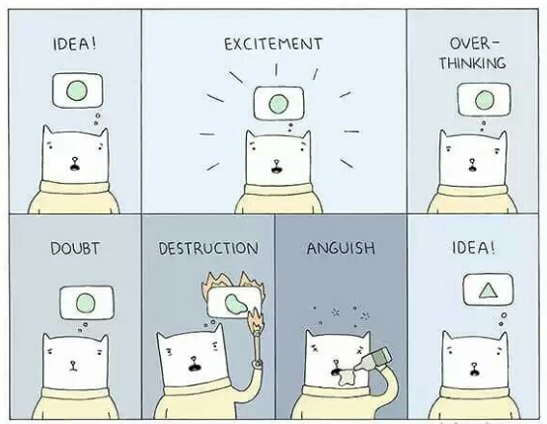
Self study -
IT and Informationsystems
2023

Slide 2

Self-study IT and Information systems
Find an academic topic related to IT and Information systems
Conduct a literature search
Write
An introduction (motivate and clarify)
Theory chapter(s)
A summary
Preferably with thoughts about further research or own views on the topic

Slide 3

How to start
Search for a topic YOU find interesting. Preferably based on other courses and lectures:
Various academic topics proposed by our program coordinator:
Safety
IoT (Internet of Things)
GDPR (General Data Protection Regulation)
Technical solutions
Artificial intelligence

Slide 4

Sharpen the theme
The theme is general
The issue or problem statement is specific
You MUST "sharpen" the theme, but you don’t necessarily have to have a specific problem that you have to answer
IoT - Internet of things
IoT, security and privacy
How does IoT affect our daily lives?
How can IoT help the elderly or disabled?
What technical solutions are used in IoT today, and what new solutions may apply in the future?
What does the future hold for IoT?
Etc.

Slide 5
Structure
Introduction
Explain why this topic / issue is interesting
Motivate the reader to want to read the rest
Feel free to use numbers and facts to "trigger" and justify why it is useful to know more about this issue (how many people have access to something or use something, what have researchers concluded on, etc.)
Literature search (explain how you did the search)
Which search words were used
Which Databases were used
Why did you use this article and not this one
etc.
Theory
Define what you are talking about (theoretical definitions/explanations of concepts)
What do we know about this issue today
Research and textbooks
Public debate (newspapers, etc.)
Conclusion/Summary

Slide 6
Example
Theme - Technology stress
Search for research paper and articles about the theme
Read and decide which approach/question connected to the theme - technology stress, you would like to answer
based on what you find interesting and what you can find information about
Problem statement - How can user motivation affect burnout caused by technology stress?

Slide 7

The start of the Introduction chapter
Introduce the theme and show that it is an important theme!
1. Introduction
The use of digital technology and work are inseparable phenomena in most professions today. Many workers have both a mobile phone and a laptop available while at work. The use of these technologies has streamlined work tasks and made a positive contribution to job performance.
However, it is not the case that the use of technology is only about efficiency, increased performance and benefits, it can also be about a more and more unclear distinction between work and leisure, as well as 24/7 accessibility in a work context.
Research has shown us that technology use is related to increased job pressure, great complexity in job performance, continuous technological changes and an increased degree of work-home conflicts (Jensen, 2017).

Slide 8

The middle and the end of the introduction chapter
2. Refer to research or known facts in the subject area
3. Point out the focus in this paper
Research has shown us that technology use is related to increased job pressure, great complexity in job performance, continuous technological changes and an increased degree of work-home conflicts (Jensen, 2017).
All of these factors can contribute to technology stress among employees, which in its extreme consequence can lead to burnout and increased sickness absence (Nielsen, 2018).
Research has also shown that technology stress can be prevented through good offer of training and user support (Zao, 2018). Both training and user support have their main contribution in the form of increased user competence and motivation (Bostrom, 2016).
The focus of this work is on user motivation and how it can affect burnout caused by technology stress.

Slide 9
The literature search chapter
2. Literature search
In this chapter, we will describe how the search for theory and research articles dealing with motivation and/or technology stress was carried out.
The table present the search word and databases used, and the articles and literature we decided to use:
Literature matrix showing the findings? Possibly in the appendix
Use: A-tekst, ORIA, Google-scholar, Google etc.
You can find previous Bachelor and Master theses from USN students here: USN Open Archive
Database | Search word | Result

Slide 10
Theory chapter
Use a heading that describes
the chapter content,
NOT just theory chapter
3. User motivation and technology stress
As described in the introduction, the purpose of this work is to look more closely at the importance of user motivation to reduce technology stress among employees.
We will start with a description of self-determination theory in chapter 3.1.
In the next chapter, technology stress will be described, and the consequences of technology stress will be discussed (chapter 3.2). In chapter 3.3, we will present some empirical research articles that deal with motivation and stress, and in chapter 3.4 we will draw some conclusions and write a summary.
3.1 User motivation in light of self-determination theory
3.2 Technology stress
3.3 Research on motivation and stress
3.4 Summary

Slide 11
More than one theory chapter
2. User motivation and technology stress
2.1 User motivation in light of self-determination theory
2.2 Technology stress
2.3 Research on motivation and stress
2.4 Summary
3. IT training and user support
3.1 IT training
3.2 User support
3.3 Summary
The length of a chapter should be more than one page.
If you only want to write some sections about a specific topic, use a ball point to separate the topics or nothing at all. Don't make a whole chapter with only two sentences or two written sections.

Slide 12
Conclusion/Summary
It is important that the problem is followed up and answered as best as possible.
The answer must be based on the theory that has been presented.
4. Conclusion
In this last chapter, we will give a brief summary of the theory that was presented in the previous chapters, before we formulate a conclusion or a kind of answer to the problem. We have also chosen to post some of our own thoughts and opinions along the way in this chapter.
The problem statement was the following:
How can user motivation affect burnout caused by technology stress?
We found that user motivation and technology stress are related in the way that ... (reference), but it can also be that …. or ….

Slide 13
Report submission
The report is a "home exam" and constitutes 100% of the grade on the course.
The report may be written in English or Norwegian
The submission deadline will be announced on WiseFlow and Canvas.
The deadline in 2021 was 22.11

Slide 14
Requirements
Maximum 2 students per assignment.
The report must not exceed 20 - twenty – pages.
The front page must contain the thesis title and exam number (s).
Table of contents starts on page 2.
Then follows the actual exam answer, followed by a reference list and any attachments.
Page numbers should be inserted in the middle at the bottom of each page.

Slide 15
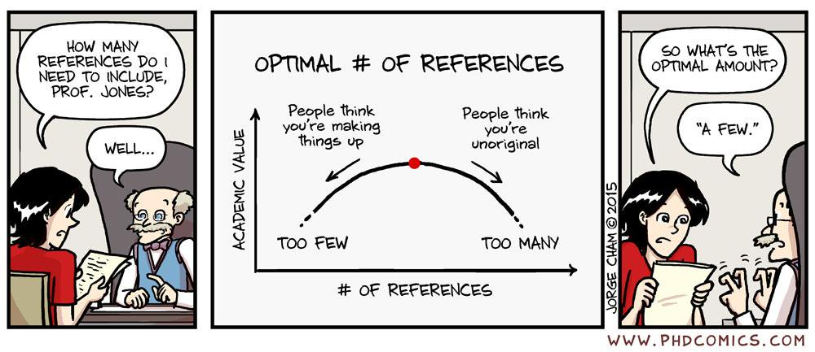
Reference style
References must be used in line with the professional tradition and the professional literature the thesis relates to.
Therefore, start with a specific style and implement it consistently (feel free to use a specific reference style from a scientific journal).
Use endnote.

